Slide 1

Decentralized Land Record Management
[Soumen Bhunia]

Slide 2

PROBLEM STATEMENT
Traditional land ownership records are vulnerable to fraud, disputes, and inefficiencies due to centralized or manual record-keeping. A blockchain-powered Land Registry System enhances security, transparency, and immutability in land registration and ownership transfers. By leveraging smart contracts, the system automates verification, eliminates forgery, and ensures that only legitimate owners can transfer property.

Slide 3
Project Description
Decentralized Ownership: Eliminates reliance on centralized authorities for land registration.
Immutable Records: Blockchain ensures land data cannot be altered or forged.
Smart Contract Enforcement: Automates ownership verification and transfer processes.
Fraud-Resistant System: Prevents duplicate or unauthorized land registrations.
Trustless Transactions: Eliminates intermediaries, reducing delays and costs.
Real-Time Verification: Anyone can instantly check property details on the blockchain.
Proof of Authenticity: Only verified owners can initiate property transfers.
Tamper-Proof Digital Ledger: Ensures permanent, transparent land records.
Ethereum-Based Architecture: Uses Solidity smart contracts for security and efficiency.
Global Accessibility: Provides cross-border verification of property ownership.

Slide 4

WHO ARE THE END USERS?
Regulatory Bodies & Government Agencies – Oversee and enforce land registration policies.
Landowners & Prospective Buyers – Register, verify, and transfer property securely.
Banks & Financial Institutions – Verify land ownership for loans, mortgages, and investments.

Slide 5

Technology Used
Development Environment: Remix IDE
Smart Contract Language: Solidity

Slide 6
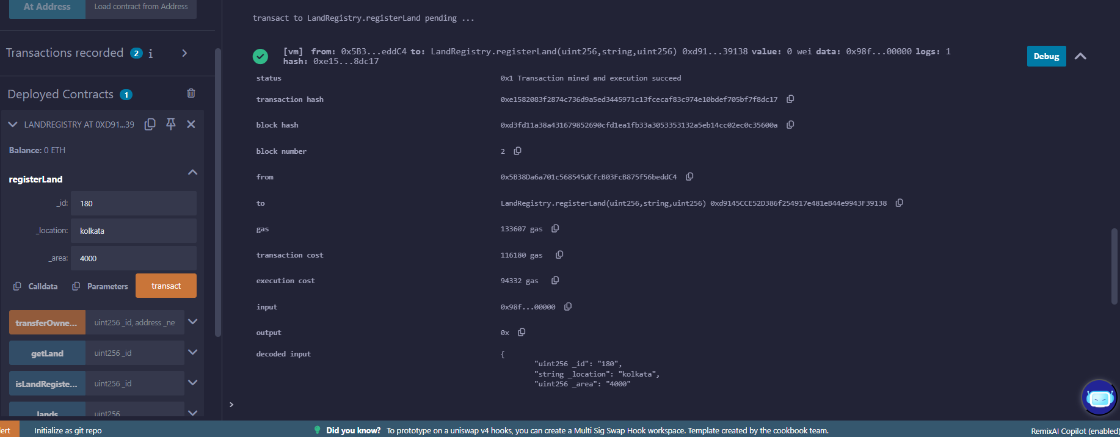
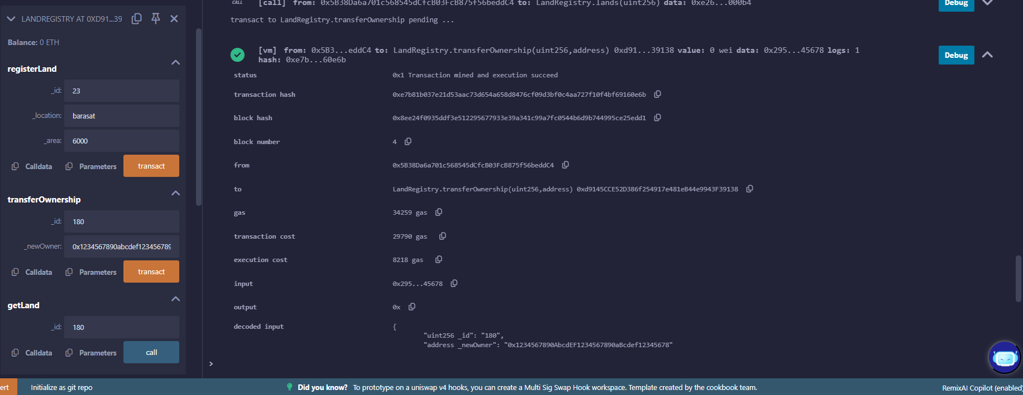
RESULTS
1st output
2nd output
https://github.com/Alpha-Soumen/Decentralized-Land-Record-Management

Slide 7
Thank you
.
.

